Slide 1
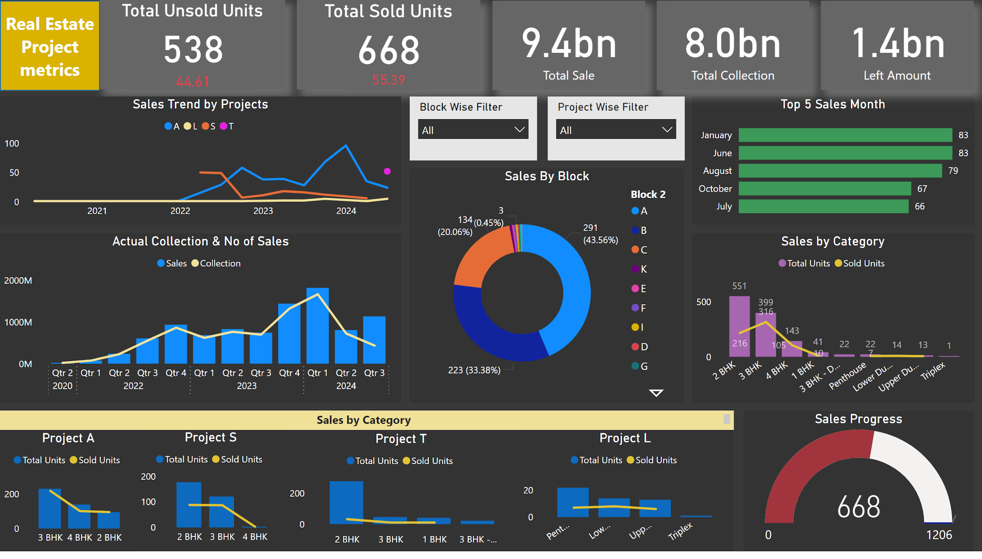
Notes:
Actual Collection & No of Sales
No alt text provided
Sales By Block
No alt text provided
Top 5 Sales Month
No alt text provided
actionButton
No alt text provided
Total Sold Units
No alt text provided
Total Unsold Units
No alt text provided
Sales Progress
No alt text provided
Total Sold
No alt text provided
Total Sold
No alt text provided
Total Sold
No alt text provided
Sales Trend by Projects
No alt text provided
Sales by Category
No alt text provided
Project A
No alt text provided
Project S
No alt text provided
Project L
No alt text provided
textbox
No alt text provided
slicer
No alt text provided
Project T
No alt text provided
card
No alt text provided
card
No alt text provided
slicer
No alt text provided
Project A
No alt text provided

Slide 2
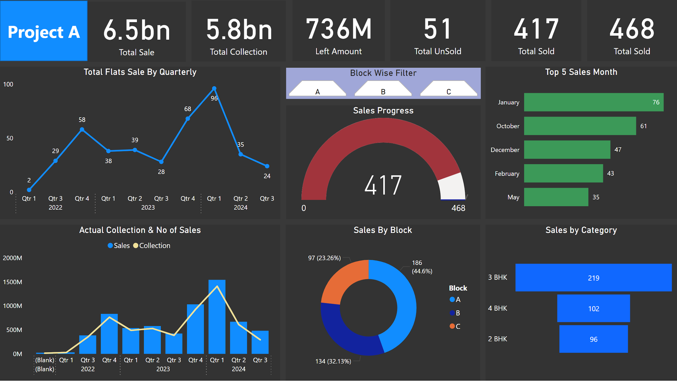
Notes:
Actual Collection & No of Sales
No alt text provided
Sales By Block
No alt text provided
Sales by Category
No alt text provided
Top 5 Sales Month
No alt text provided
actionButton
No alt text provided
Total Sold
No alt text provided
Total Sold
No alt text provided
Sales Progress
No alt text provided
Total Sold
No alt text provided
Total Sold
No alt text provided
Total Sold
No alt text provided
Total Flats Sale By Quarterly
No alt text provided
Total Sold
No alt text provided
Block Wise Filter
No alt text provided
Project A
No alt text provided

Slide 3
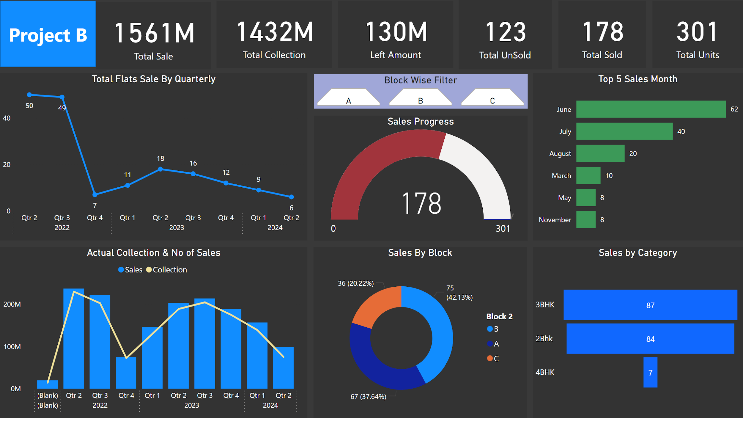
Notes:
Actual Collection & No of Sales
No alt text provided
Sales By Block
No alt text provided
Sales by Category
No alt text provided
Top 5 Sales Month
No alt text provided
actionButton
No alt text provided
Total Sold
No alt text provided
Total Sold
No alt text provided
Sales Progress
No alt text provided
Total Sold
No alt text provided
Total Sold
No alt text provided
Total Sold
No alt text provided
Total Flats Sale By Quarterly
No alt text provided
Block Wise Filter
No alt text provided
Total Sold
No alt text provided
Project A
No alt text provided

Slide 4
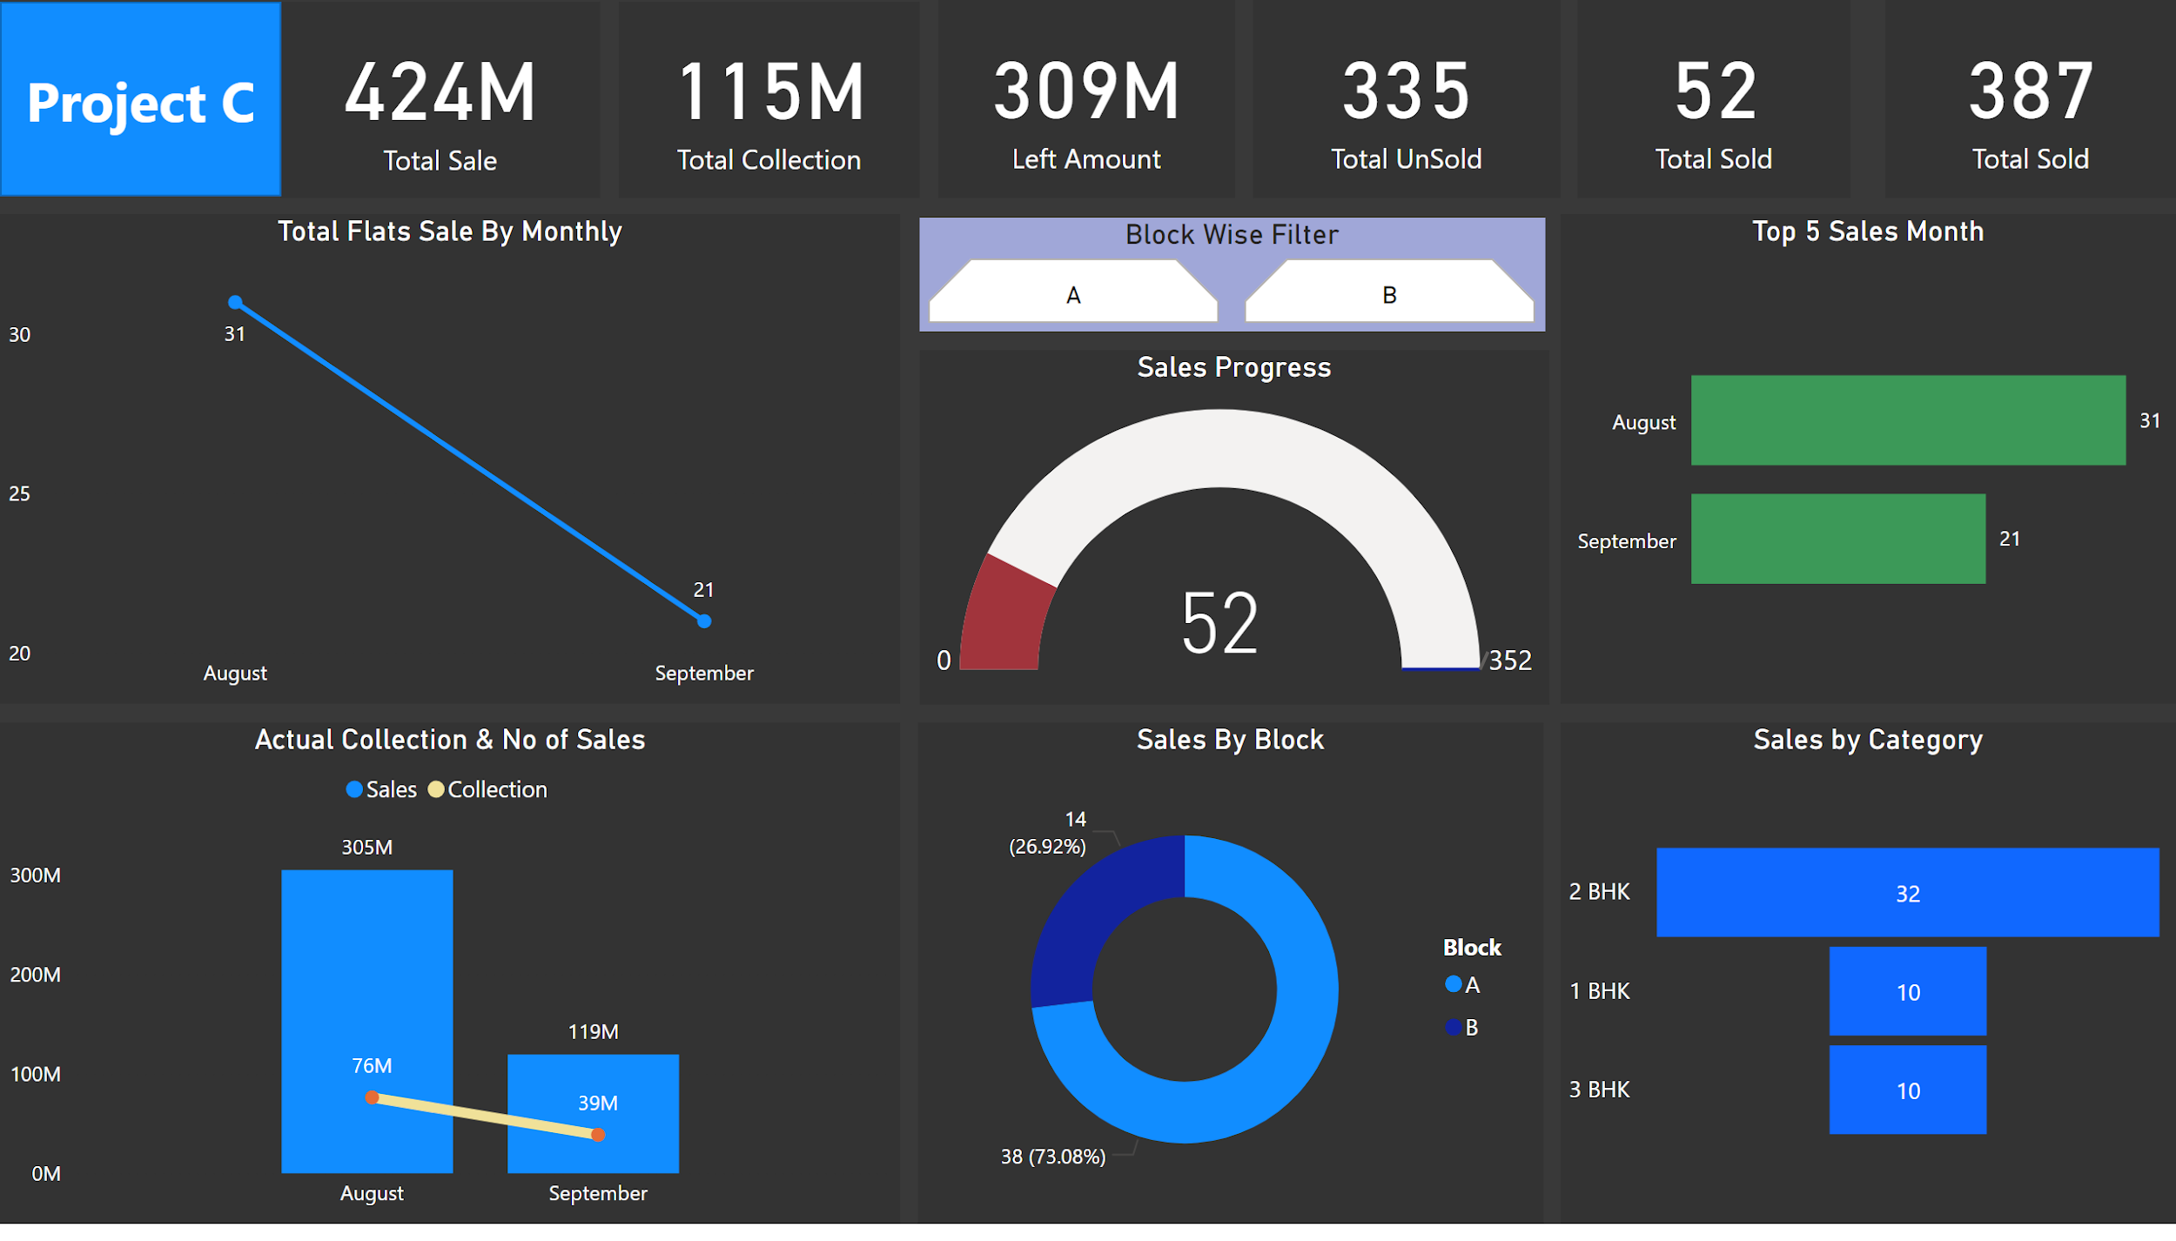
Notes:
Actual Collection & No of Sales
No alt text provided
Sales By Block
No alt text provided
Sales by Category
No alt text provided
Top 5 Sales Month
No alt text provided
actionButton
No alt text provided
Total Sold
No alt text provided
Total Sold
No alt text provided
Sales Progress
No alt text provided
Total Sold
No alt text provided
Total Sold
No alt text provided
Total Sold
No alt text provided
Total Flats Sale By Monthly
No alt text provided
Block Wise Filter
No alt text provided
Total Sold
No alt text provided
Project A
No alt text provided

Slide 5
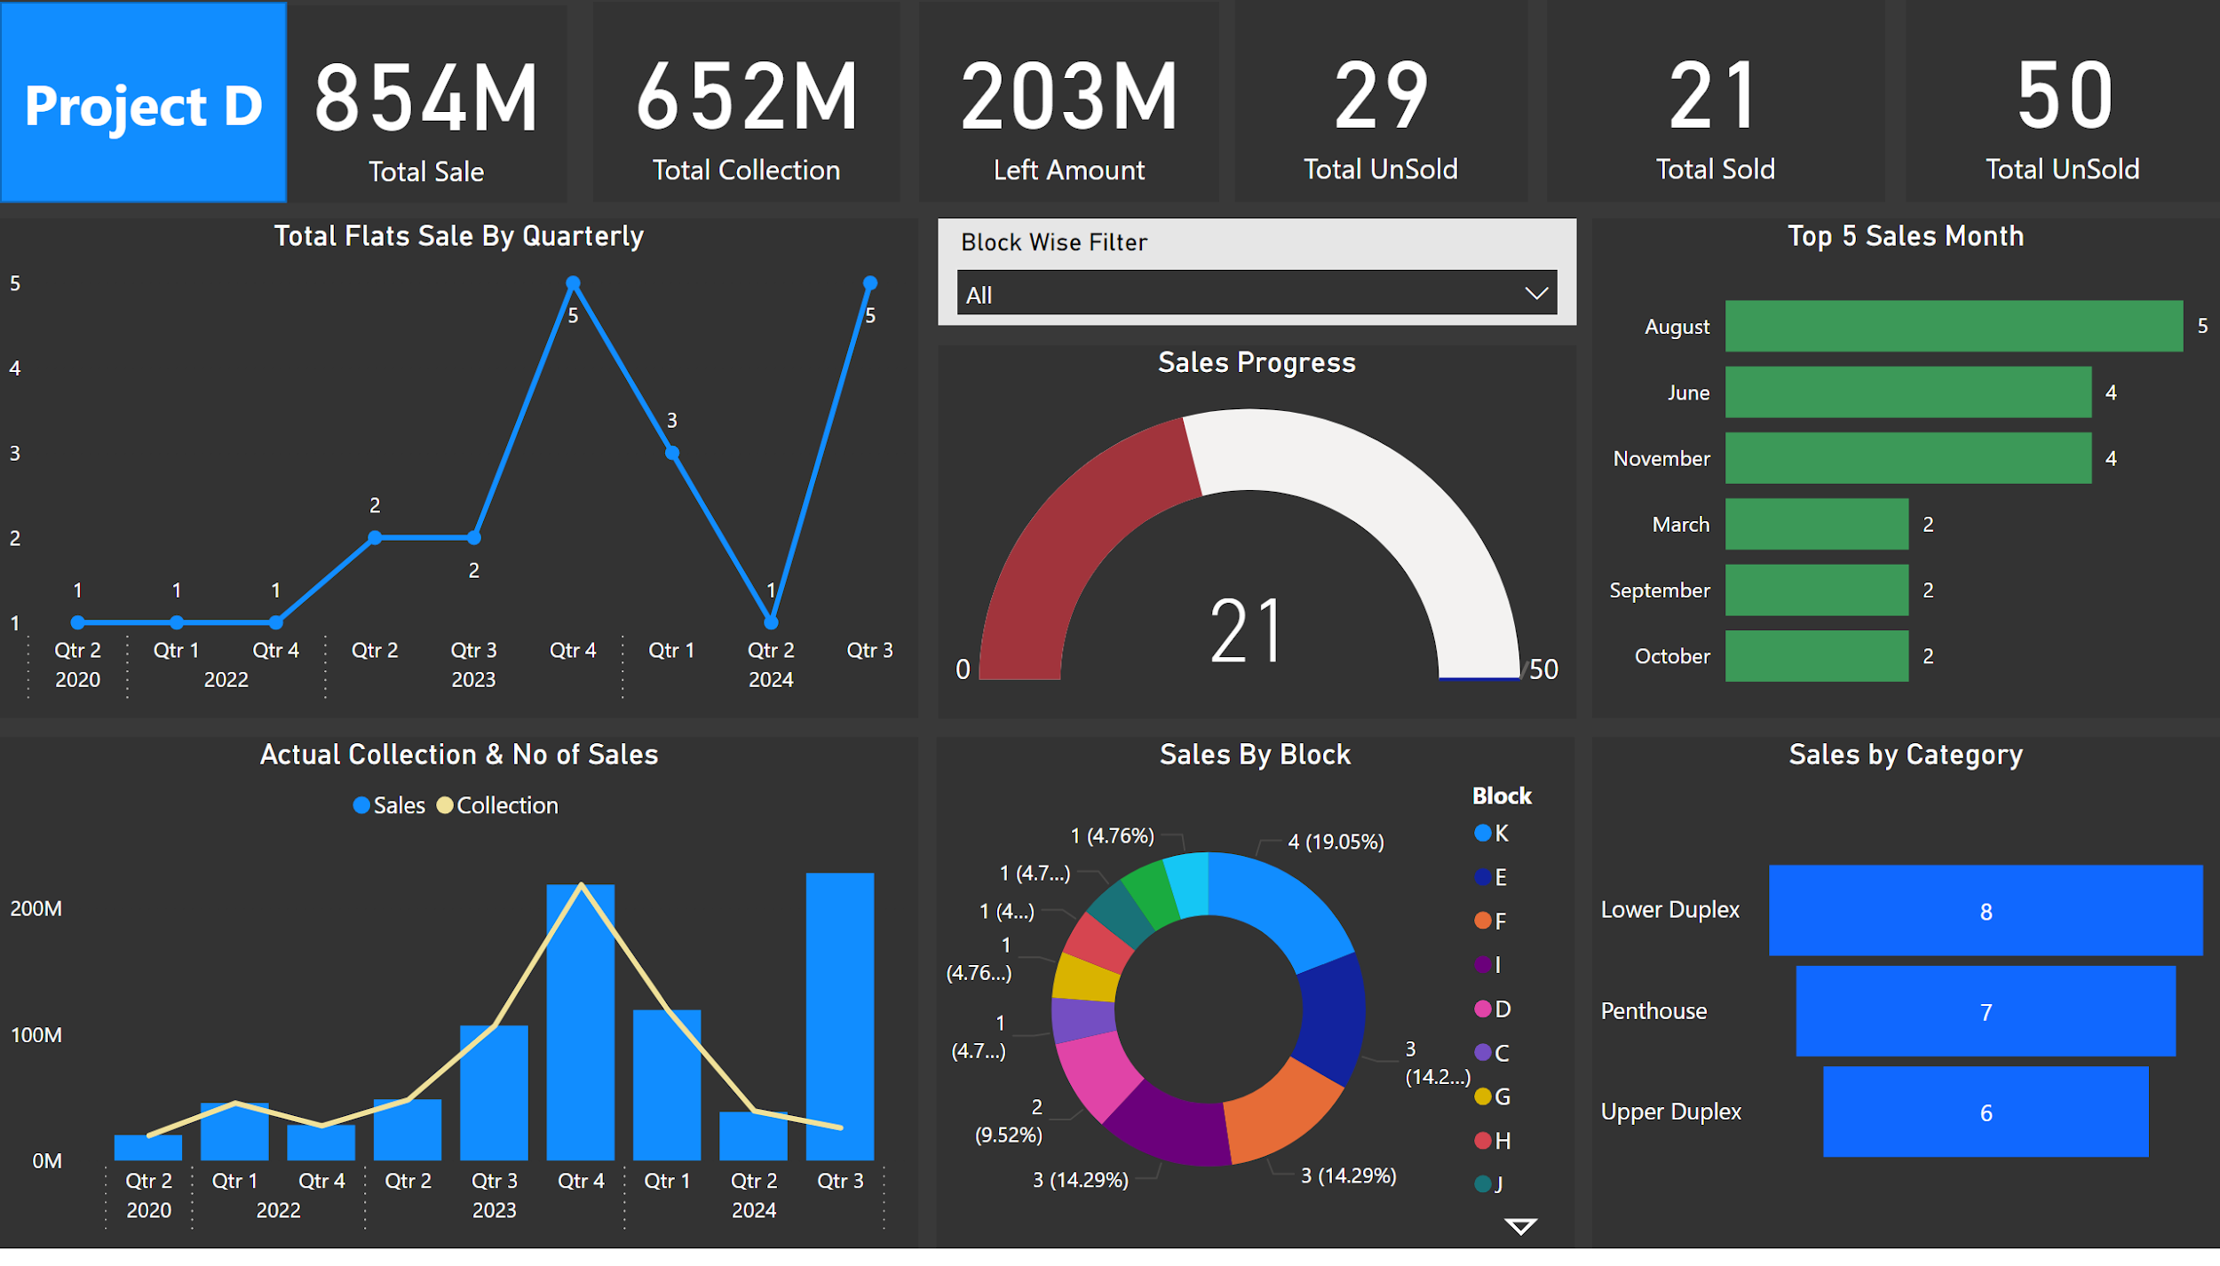
Notes:
Actual Collection & No of Sales
No alt text provided
Sales By Block
No alt text provided
Sales by Category
No alt text provided
Top 5 Sales Month
No alt text provided
actionButton
No alt text provided
Total Sold
No alt text provided
Total Sold
No alt text provided
Sales Progress
No alt text provided
Total Sold
No alt text provided
Total Sold
No alt text provided
Total Sold
No alt text provided
Total Flats Sale By Quarterly
No alt text provided
slicer
No alt text provided
Total Sold
No alt text provided
Project A
No alt text provided

Slide 6
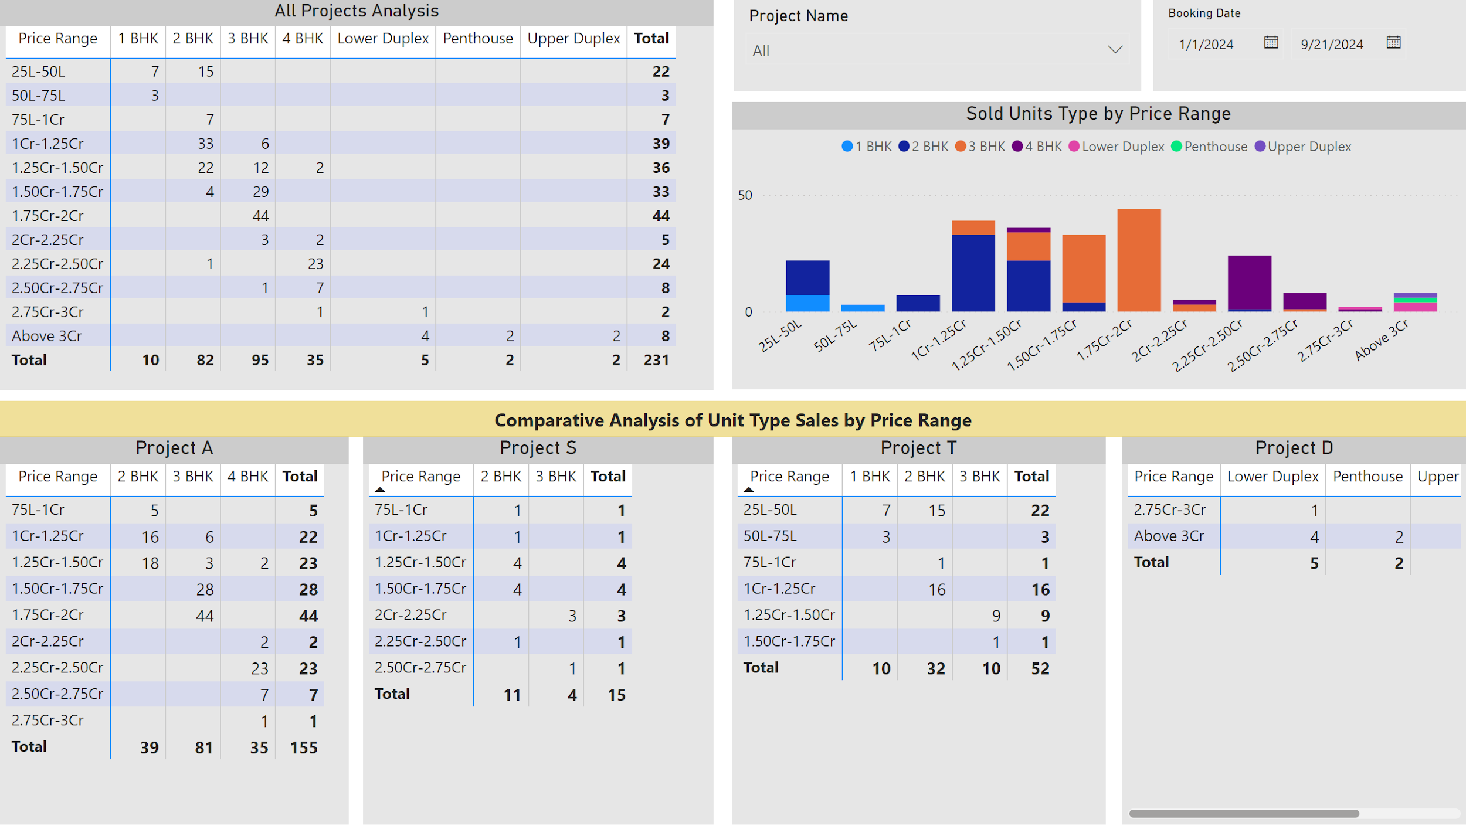
Notes:
All Projects Analysis
No alt text provided
slicer
No alt text provided
Project A
No alt text provided
Project S
No alt text provided
Project T
No alt text provided
Project D
No alt text provided
textbox
No alt text provided
Sold Units Type by Price Range
No alt text provided
slicer
No alt text provided

